Slide 1

MoneyHeist 2.0
Machine Learning enabled Supervised Learning Model for identification of Malicious Ransomware Transactions in a heterogeneous Bitcoin network

Slide 2
Why Bitcoin for Ransom Attacks ?
Widespread User-Base and Convertible
Anonymity
Automation and Incontrovertible Nature
Anonymous Networks

Slide 3

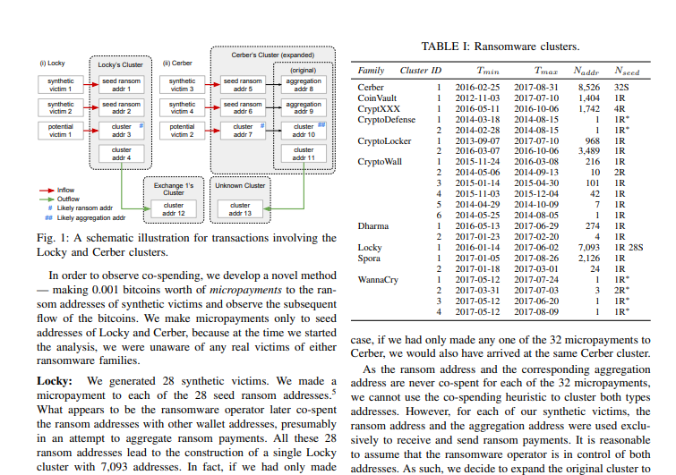
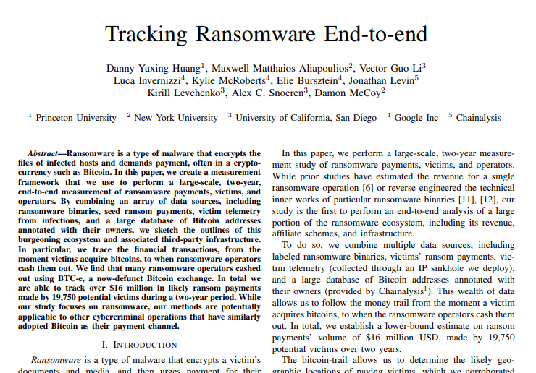
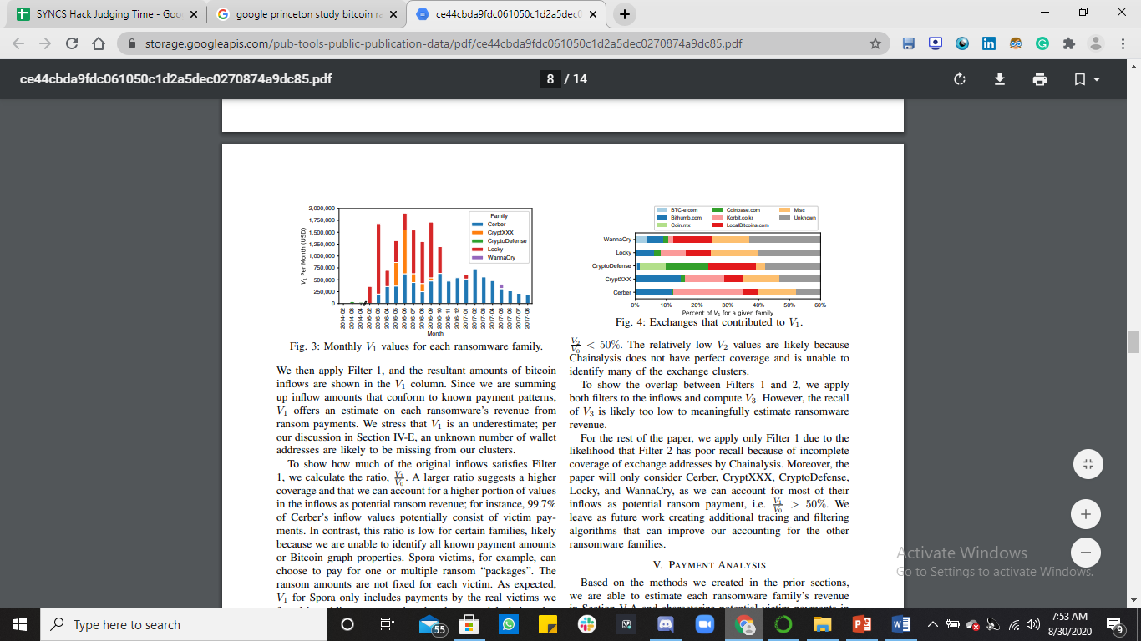
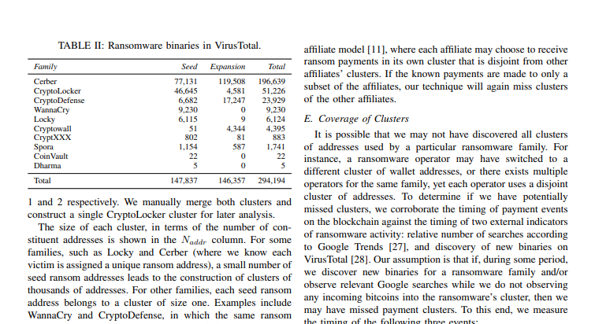
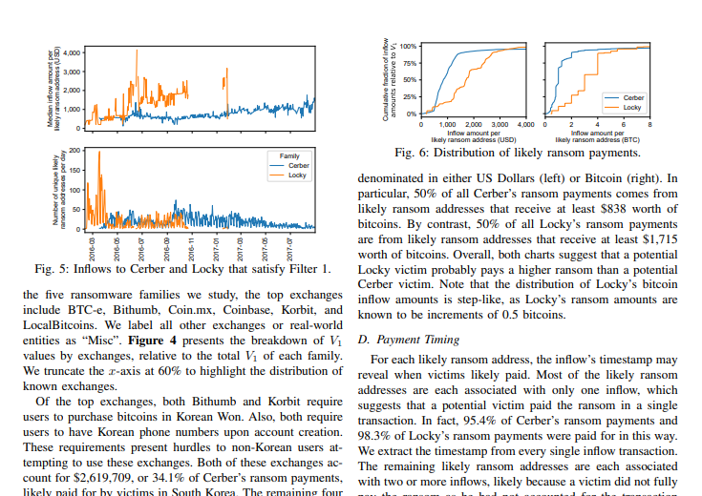
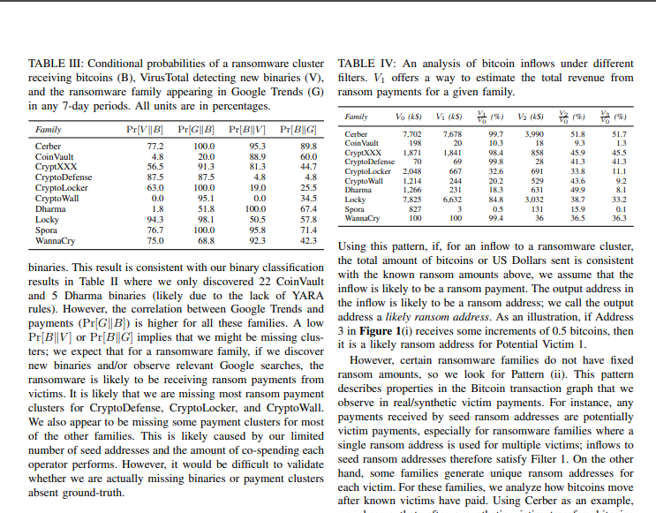
IEEE Symposium on Security and Privacy

Slide 4
AIM

Slide 5
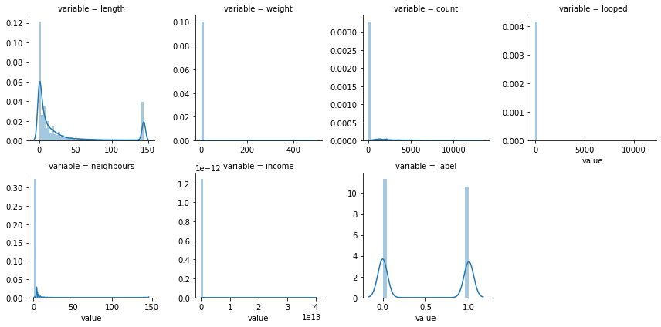
Dataset
80,000 Data Points !
Jan of 2009 to December of 2018
Montreal, Princeton and Padua
If Network Edge <B0 0.3
25 % Test Dataset
Facet Grid of Data

Slide 6
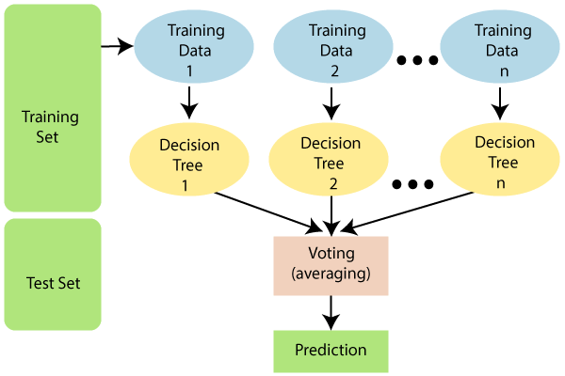

Slide 7
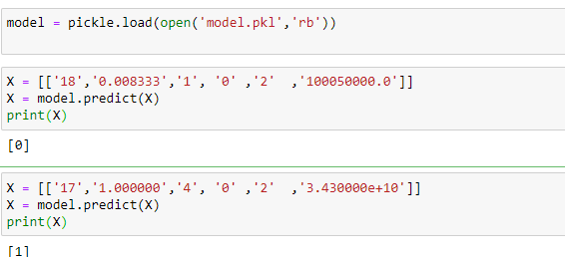
precision recall f1-score support
0 0.79 0.92 0.85 10380
1 0.89 0.74 0.81 9620
accuracy 0.83 20000
macro avg 0.84 0.83 0.83 20000
weighted avg 0.84 0.83 0.83 20000

Slide 8
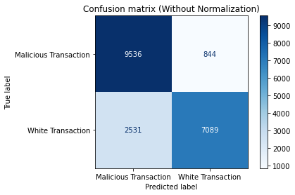
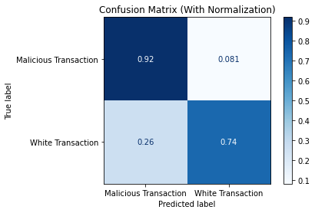

Slide 9
THANK YOU

